Slide 1


Grants to Engage Men and Boys as Allies in the Prevention of Violence Against Women and Girls Program:
EM Program Deep Dive
OVW Grant Managers Derek O’Leary and Traci Rollins
December 11, 2024
12/5/24
1

Slide 2
Session Overview
What is the Engaging Men (EM) Program and what do EM grant projects do?
What are my responsibilities as an EM grant recipient or sub-recipient?
How can my team work effectively with OVW to implement a successful grant project?
How do we modify our grant project activities and budget?
How can we make the most of our award?
12/5/24
2

Slide 3
1.What is the Engaging Men (EM) Program and what do EM grant projects do?
12/5/24
3

Slide 4
Meet the OVW CYEM Unit
Krista Blakeney-Mitchell, Associate Director
Anne Hamilton, Team Lead
Elaina Roberts, Grant Management Specialist
Derek O’Leary, Grant Management Specialist
Traci Rollins, Grant Management Specialist
Sheila Griese, Program Analyst

Slide 5
The Engaging Men Program
EM at a glance
The EM Program supports community-led projects that develop and implement strategies that engage, mobilize, and empower men and boys at individual, group, relational, and societal levels to serve as role models, positive influencers, change agents, and mentors to address and prevent domestic violence, dating violence, sexual assault, and stalking.
The only OVW program focused on prevention
Authorized by the SMART Prevention statute
Three-year grants up to $350,000 total
Oct. 1 2024 to Sept. 30, 2027
~30 active grant recipients
Ten new EM grants awarded in Fiscal Year 2024
12/5/24
5

Slide 6
EM Purpose Area
To implement education, training, or other programming that enables men and boys to serve as allies in the prevention of domestic violence, dating violence, sexual assault, stalking, and sex trafficking.
12/5/24
6

Slide 7
What activities must you implement through your EM project?
1. Identify males to serve as role models, positive influencers, change agents, and/or mentors.
2. Adopt a specific model and/or strategies that will be utilized to meet the goals and objectives of the proposed project.
3. Identify and adopt project goals and objectives that will integrate education on domestic violence, dating violence, sexual assault, stalking, and/or sex trafficking, into existing male-focused programs.

Slide 8
OVW Priority Area for the EM Program
Advance equity and tribal sovereignty as essential components of ending sexual assault, domestic violence, dating violence, and stalking by improving outreach, services, civil and criminal justice responses, prevention, and support for survivors from historically marginalized and underserved communities, particularly those facing disproportionate rates or impacts of violence and multiple barriers to services, justice, and safety.
12/5/24
8

Slide 9
EM Program-specific priority
In response to the widespread and increasing harm posed by the distribution of non-consensual intimate images, deep fakes, online enticement, sextortion, cyberstalking, and other forms of technology-facilitated abuse, the EM Program has identified the prevention of technology-facilitated abuse as a program-specific priority.
12/5/24
9

Slide 10
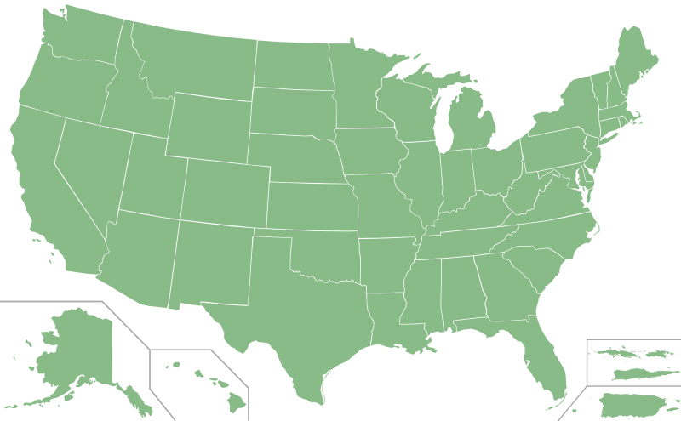
EM Grants in FY 2024
Idaho Coalition against Sexual and Domestic Violence
Battered Women’s Shelter of Summit and Medina Coutnies
DC Coalition to End Sexual Violence
Options for Youth
Malouf Foundation
Peaceful Families Project
Hubbard House
Tabernacle Church of God in Christ
The Carrie Meek Foundation
Boys and Girls Clubs of Puerto Rico

Slide 11
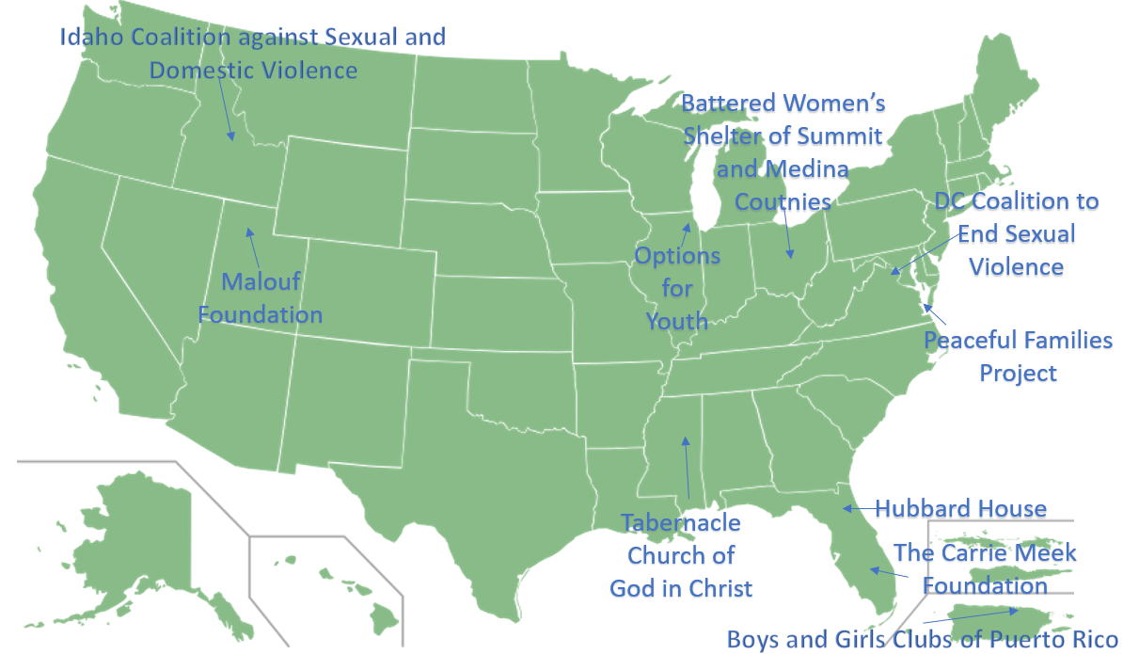
Connect with someone from another EM project and share about your work:
What was your path to this Engaging Men work?
What are your goals for your EM project?
As you start your project, what are you most enthusiastic about? Most uncertain about?
12/5/24
11

Slide 12
Questions so far about the EM Program?

Slide 13
2. What are my responsibilities as an EM grant recipient or sub-recipient?
12/5/24
13

Slide 14
Grant project timeline
Budget clearance (~1-3 months)
OVW approves your (revised) budget
Planning Phase (~3-6 months)
Planning meetings with OVW and TA providers
Project implementation (rest of grant period)
Approved project activities
Project closeout
$10k available only for required new grantee orientation
Grantee and partner submit required policies and project workplan
$50k total available to conduct only planning activities
Full $350k available
12/5/24
14

Slide 15
Planning Phase
What is the planning phase?
An opportunity at the beginning of your grant for the project lead and project partner(s) to collaboratively prepare to implement your project.
OVW and the THRIVE TA team will provide direct support throughout this process.
12/5/24
15

Slide 16
Planning Phase Process
Kick-off meeting: Project lead, project partner, OVW grant manager, and TA point of contact
Allowable activities: Project lead and partners complete necessary activities to prepare for your project implementation
Wrap-up meeting: Planning phase wrap-up meeting with same participants
Work plan and required policies: Project lead submits project work plan and require policies on JustGrants
Approval: OVW grant manager approves completion of planning phase and releases full funds
16

Slide 17

Allowable planning phase activities*
  Development of project partnership and coordinated community response
  Refining project focus and increasing capacity to implement project
  Hiring project staff
  Developing project lead’s and required partner’s policies
  You may only begin to implement approved project activities after you have completed the planning phase.
*During the planning phase, continuation grantees can continue to implement activities approved under their previous grant

Slide 18
It is a planning phase requirement to submit all of these required policies for both the lead organization and the required partner.
The THRIVE TA team can provide support developing these policies.
Please submit these as an “award deliverable” as one document in JustGrants.
You have two options to do so:
Option 1: Submit separate policies for both the lead organization and the required project partner
Option 2: Submit one set of policies that both organizations agree to follow for the grant. Include a cover letter explaining that you will do so, signed by both organizations.
Planning Phase deliverable 1 of 2: Required Policies
All grant recipients and their required partner must develop, enhance, or revise policies that address:
Confidentiality
Information Sharing
Parental consent
Mandatory Reporting
Background Checks

Slide 19
Planning Phase deliverable 2 of 2: Work Plan
Your work plan encapsulates key information about your grant project. This includes the goals for the project and specific activities that you will implement.
During your planning phase meetings, OVW and the Thrive TA team will provide the template and guidance for completing the work plan.
After your planning phase wrap-up meeting, please submit the completed work plan as an “award deliverable” in JustGrants.
All grant recipients and their required partner must collaboratively develop and submit a work plan.

Slide 20
Coordinated Community Response (CCR)
What are the requirements for your CCR?
  Creating or expanding a coordinated community response (CCR) team to guide project activities. The CCR team must meet regularly to design a project implementation plan, discuss project goals and activities, review successes and challenges, and ensure project activities are coordinated across the community served. The members of the CCR team should be chosen to meet the needs of the community and the project activities.
  Cross-training project staff, partner organizations/programs, and CCR team members to expand their knowledge and skills to better understand each other’s roles as well as improve the project and activities.
12/5/24
20

Slide 21
Crisis Intervention at all Events
It is a program requirement to ensure the availability of crisis intervention assistance for children, youth, and community members at all educational, outreach, and training events not specifically targeted to first responders or allied professionals.
12/5/24
21

Slide 22
Research projects
Direct victim services
Supervised visitation or exchange
Perpetrator services
Sexual harassment, bullying, and hazing (outside the context of preventing domestic violence, dating violence, sexual assault, stalking, and sex trafficking)
Substance abuse (outside the context of preventing domestic violence, dating violence, sexual assault, stalking, and sex trafficking)
Ceremonies, celebrations, and entertainment
Athletics
Technical assistance and training (to other entities)
Trademarks
Regional or statewide activities
What activities are out-of-scope for your EM project?
Your EM grant cannot be used to fund these activities.

Slide 23
What costs are unallowable for your EM project?
Lobbying
Fundraising
Purchase of real property
Physical modifications to buildings (including minor renovations such as painting)
Construction
Your budget cannot include costs for any of these activities.

Slide 24
Questions so far about EM Program requirements?

Slide 25
3. How can my team work effectively with OVW to implement a successful grant project?
12/5/24
25

Slide 26
Working with your OVW Grant Manager
Grantees are assigned to an OVW grant manager based on their state or territory
Develop a relationship with your OVW Program Specialist (Derek, Elaina, or Traci) and communicate proactively.
Feel welcome to email, call, and schedule meetings as needed.
Let us know how we can best support your work. We’re here to help.

Slide 27
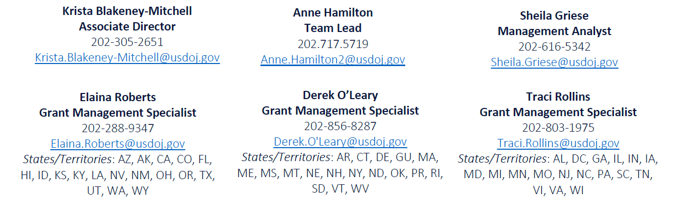
EM Unit and State assignments by Grant Manager

Slide 28
DOJ Justice Grant System (JustGrants)
DOJ wide system used to apply for and manage DOJ awards
Every grant administrative procedure is conducted in JustGrants
  Application submission; award acceptance
  Budget approval
  Submission of deliverables and grant award modifications (GAMs)
  Submission of performance and financial reports
  Entity role management

Slide 29
In JustGrants, your Entity Administrator should assign staff to the relevant roles:
Authorized Representative
Grant Award Administrator
Alternative Grant Award Administrator
Financial Manager
Please keep these up to date and do not assign the same person to all roles.
Assigning Users in JustGrants
Assign all relevant roles to project staff in JustGrants. This allows staff to use JustGrants for essential tasks, such as submitting reports and project deliverables.

Slide 30
Project Deliverables
Your award conditions require that you submit for approval all products developed and/or used with grant funds.
Prior to using a product, you must submit it on JustGrants. OVW must approve the product before you implement it. OVW must have sufficient time to review and approve a product. This might include a request for you to revise the product before it is approved.
Products that require approval include:
Brochures, flyers, newsletters, and posters
Educational and training materials
Websites and social media content or campaigns
Audio and videos
Event materials (such as promotions, agendas, presentations, handouts)
Non-English translations

Slide 31
OVW Disclaimer
Your award conditions require that the OVW disclaimer must be on all materials. This includes products and materials created by project partners.
This project was supported by Grant No. __________________ awarded by the Office on Violence Against Women, U.S. Department of Justice. The opinions, findings, conclusions, and recommendations expressed in this publication/program/exhibition are those of the author(s) and do not necessarily reflect the views of the U.S. Department of Justice.

Slide 32
Submitting Deliverables
Example: Prevention curriculum
Develop curriculum with partner
Share materials with OVW grant manager by email for initial feedback
Submit materials as a deliverable on JustGrants
Receive approval of deliverable from OVW
Implement activity with the deliverable
Directions for submitting award deliverable on JustGrants.

Slide 33
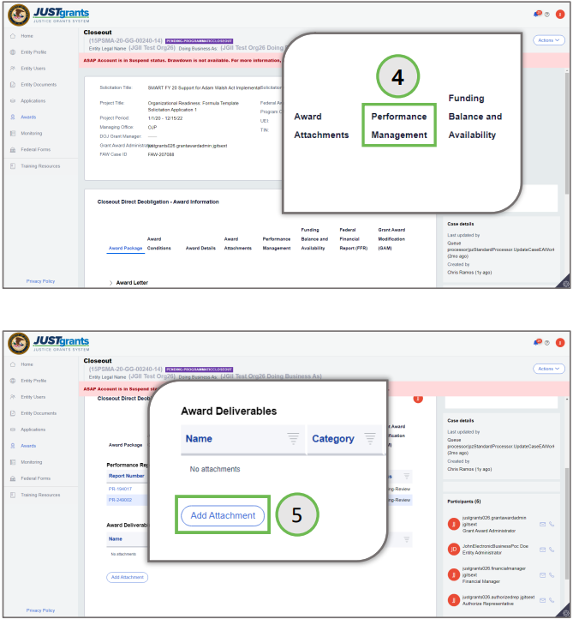
Communicate proactively with grant manager about deliverables you plan to submit, especially when it is time-sensitive.
Include brief note in the textbox to describe the deliverable.
When in doubt about whether you need to get OVW approval for something, please just ask.
Contact the OVW JustGrants helpline for technical questions: 866-655-4482 or OVW.JustGrantsSupport@usdoj.gov
Tips for Submitting deliverables

Slide 34
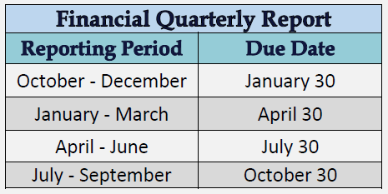
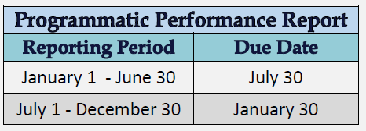
Reporting
You must submit two types of reports: a financial report each quarter and a performance report twice each year.
*Going forward, you will use the new (and improved) performance report: the IMPACT Tool. The first report with the IMPACT Tool will be due March 31, 2025 (not January 30).
12/5/24
34

Slide 35
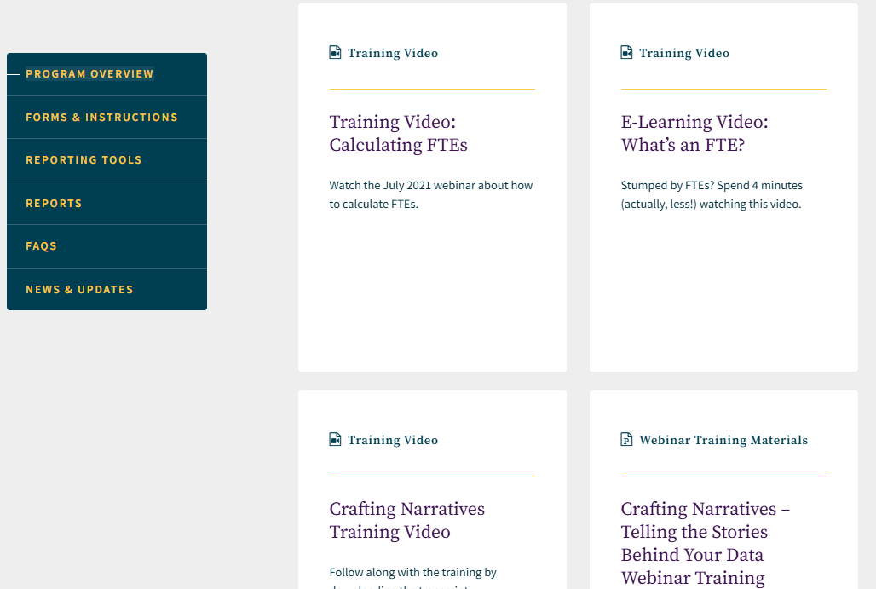
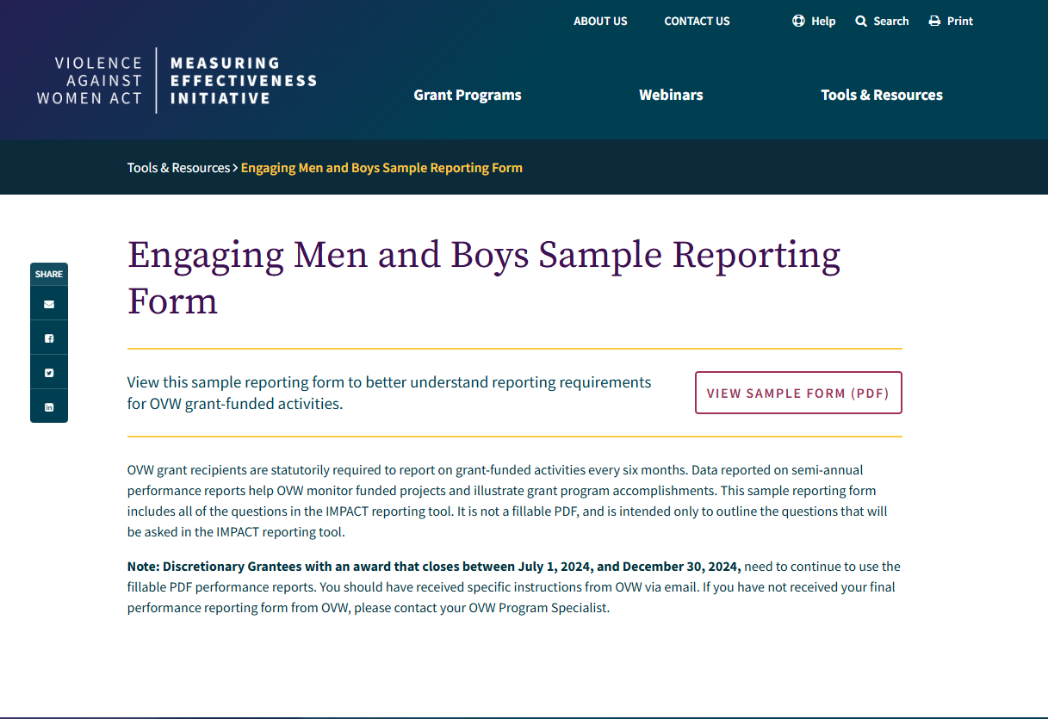
Reporting
All information about the the EM performance report is available through the Violence against Women Act Measuring Effectiveness Initiative (VAWAMEI).
This includes very helpful trainings offered by VAWAMEI. Contact them for any performance report questions:
(800) 922-VAWA or vawamei@maine.edu.
12/5/24

Slide 36
Types of OVW Monitoring
OVW monitoring
On-site
Office-based review
OVW/Office of Justice Programs financial monitoring
During your award, OVW may conduct monitoring of your project.
On-site and office-based reviews focus on your implementation of your grant project.
This programmatic monitoring typically lasts one day and requires the participation of key project staff and project partner staff.
Monitoring assesses compliance with program requirements, increases OVW knowledge of your work, and identifies any needs (such as training and technical assistance) and issues to be addressed.

Slide 37
Key Project Documents
The FY 2024 EM solicitation
Award conditions
Your project narrative
Your MOU
Your budget worksheet and narrative
Your required policies
Your work plan
Project deliverables (that is, products developed with grant funds)
Organizing these documents for your project so that relevant project staff and partners can easily access this information will support your project.

Slide 38
Questions so far about working with OVW?

Slide 39
4. How do we modify our grant project activities and budget?
12/5/24
39

Slide 40
Grant Award Modifications (GAMs)
  Programmatic GAMs
    Changes to your project staff, MOU partners, project activities or scope of the project
    Changes to approved costs
  Financial GAMs
    Modifications of your budget that are greater than 10% of the total budget or allocate funds into a new budget category
GAMs are a process in JustGrants that enables you to request changes to your project and your project budget.

Slide 41
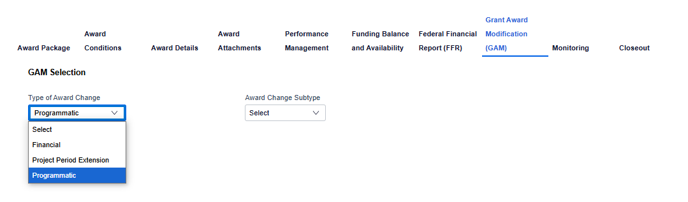
Initiating a GAM in JustGrants
Pre-made Slides

Slide 42
Examples of GAMs
Examples of GAMs
You’ve hired a new prevention specialist to implement grant-funded activities
Submit a programmatic change of scope GAM that includes the new hire’s job description and resume
You want to move $2,500 from your supplies category to your travel category to support more partner staff travel to OVW trainings
Submit a programmatic cost GAM that briefly explains the reason for the change and includes an updated budget.
You want to purchase food for weekly meetings of your youth mentoring program, which was not in the approved budget.
Submit a budget modification GAM that includes an updated budget that explains the reason for this change

Slide 43
GAMs happen. When in doubt about whether you need to submit a GAM, just reach out to your OVW grant manager to discuss and determine the right approach.
12/5/24
43

Slide 44
Questions so far about grant award modifications (GAMs)?

Slide 45
5. How can we make the most of our award?
12/5/24
45

Slide 46
Communicate actively with your OVW grant manager
Reach out for help as issues arise.
  OVW Grants Financial Management Division for financial questions: OVW.GFMD@usdoj.gov
  OVW JustGrants helpdesk for JustGrants issues: OVW.JustGrantsSupport@usdoj.gov
  VAWA MEI for performance report questions: vawamei@maine.edu
Make an effective communication plan for your staff and project partner(s)
Regularly review and assess your progress toward project goals and the impact of your project activities
Develop a plan for communication about the project among your staff, with project partners, and with OVW and the THRIVE TA team.
Engage with the THRIVE TA team and other OVW-sponsored TA resources
  Safety Net targeted TA project to promote online safety
  International Organization for Adolescents/Courtney’s House project to address sex trafficking

Slide 47
Questions?

Slide 48
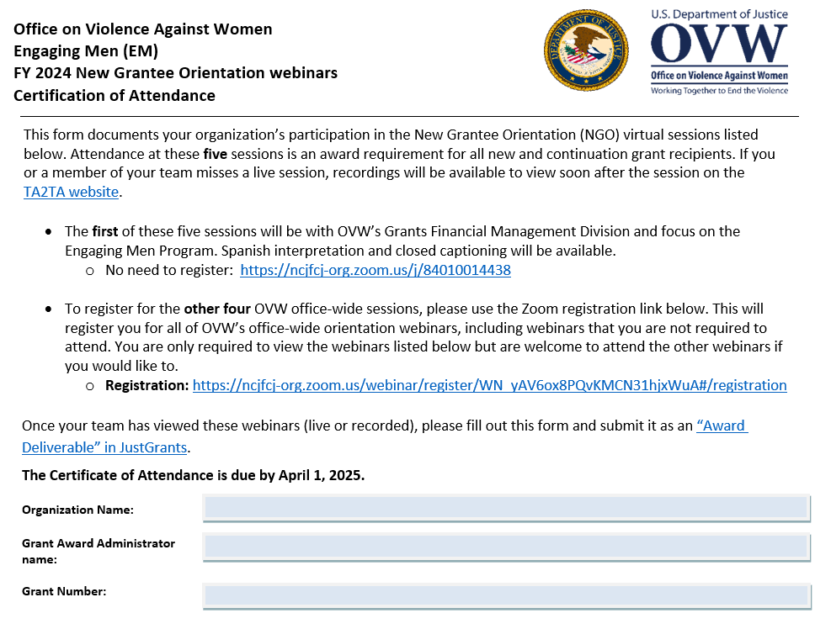
Required Virtual Webinars
Required webinars for EM grant recipients:
1) OVW Grants Financial Management Division overview
November 13, 2024, 11:30 – 1:30pm ET
2) Overview of Grant Fraud Investigations
January 15, 2025, 2:00-3:30pm ET
3) TA2TA: The TA Provider Resource Center
January 16, 2025, 2:00-3:00pm ET
4) Civil Rights Obligations of Federal Recipients of Financial Assistance
January 27, 2025, 2:00 to 3:30pm ET
5) Overview of Grant Award Audits
January 28, 2025, 2:00 to 3:30pm ET
Recordings will be posted on TA2TA.org.
Specific project staff must attend these webinars (or view the recordings afterward). Please complete the certificate of attendance and submit it on JustGrants by April 1.
12/5/24
48

Slide 49


The Office on Violence Against Women
Become an OVW peer reviewer:
Justice.gov/OVW/Peer-Review
Follow our social media:
  LinkedIn: LinkedIn.com/Company/Office-on-Violence-Against-Women-OVW/
  Twitter:
  Twitter.com/OVWJustice
Learn more about our grants at:
Justice.gov/OVW/Grant-Programs
The Office on Violence Against Women (OVW) provides federal leadership in developing the national capacity to reduce violence against women and administer justice for and strengthen services to victims of domestic violence, dating violence, sexual assault, and stalking.

